Slide 1


overall_1_132573879104528179 columns_1_132573879104528179
Microsoft Office Add-ins
Community call
Word Extensibility Update
Outlook Add-in Blazer Sample Update
September 14, 2022

Slide 2
Agenda
Word Extensibility Update
Outlook Add-in Blazer Sample Update
Yun Wang
Eric Legault
Principal Product Manager
Community

Slide 3
Word Extensibility Update
Yun Wang: Principal Product Manager

Slide 4
Agenda
Embed add-in into Word document
Shared runtime support
Structured document survey result
Word panel introduction

Slide 5
User’s journey to use an add-in
Traditional Way
Open add-in office store
Install the add-in
Launch add-in
Step 2
Step 4
Step 6
Step 1
Search add-in in office store
Step 3
Switch to the ribbon
Step 5
Use it!
Open in Word Pattern
Click open in Word button from your own system
Use it!
Step 2
Step 1
Open file in Word
Install and launch add-in automatically
Step 3

Slide 6
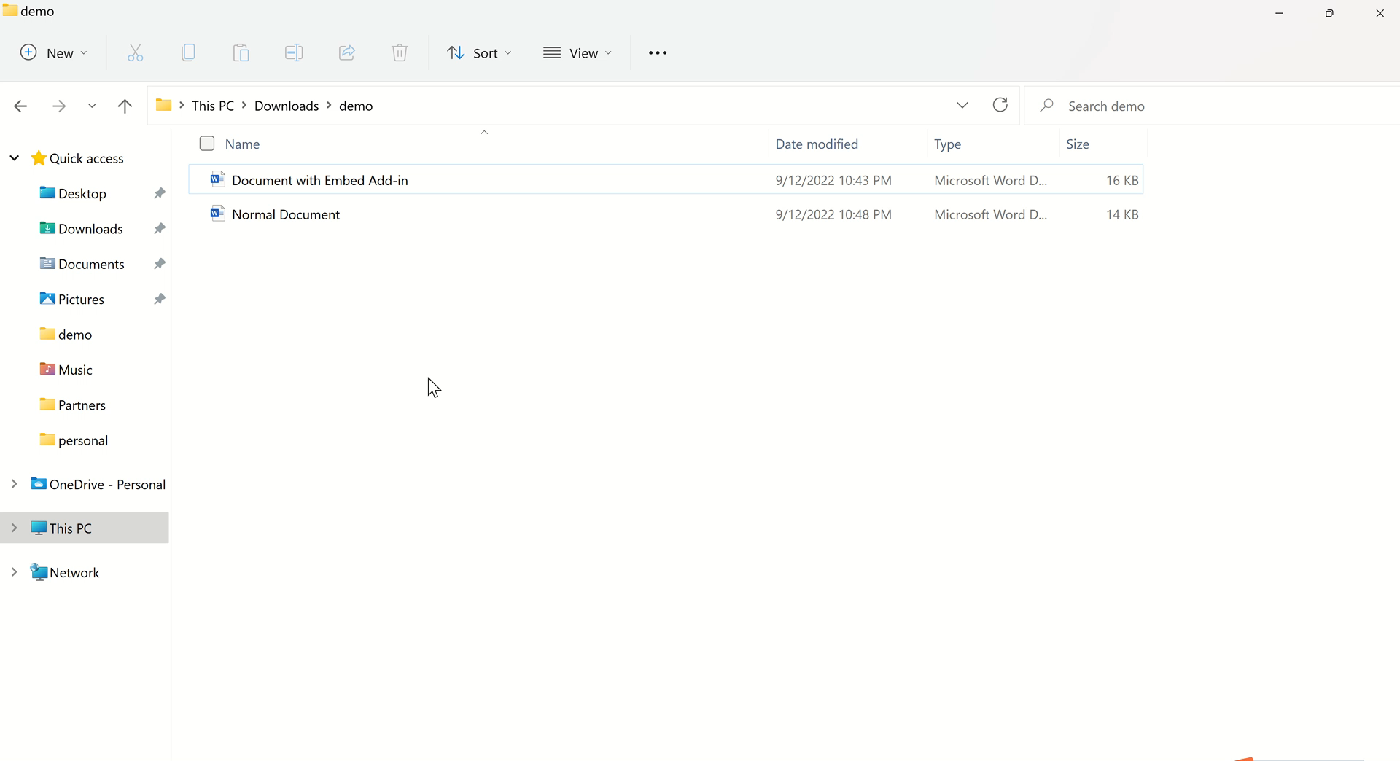
Embed Add-in into Word and open the document from your system
Feature overview
Embed an add-in into a Word document
Add-in is automatically launched when document is opened
Pass additional values to add-in
Your users no longer need to download and install add-in from store
Runnable sample code is available at https://github.com/OfficeDev/Office-OOXML-EmbedAddin
When to use it
Word is launched from your system, and it requires add-in to be opened every time
Get connected with your users when they use Word
Exposure to new users when they get the document

Slide 7
Agenda
Embed add-in into Word document
Shared runtime support
Structured document survey result
Word panel introduction

Slide 8
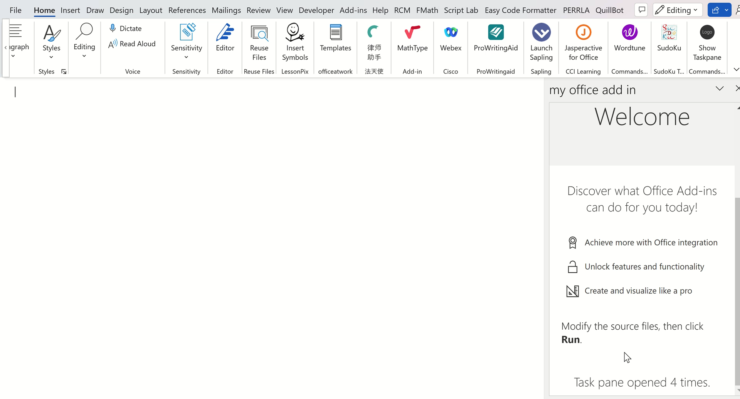
Shared runtime for Word
Shared runtime for Word can
share global variable
maintain connection to your system​
run code in your Office Add-in when the document opens
show or hide the task pane of your Office Add-in
More information:
Configure your Office Add-in to use a shared runtime - Office Add-ins | Microsoft Docs

Slide 9
Agenda
Embed add-in into Word document
Shared runtime support
Structured document survey result
Word panel introduction

Slide 10
Structured document content usage in Word add-ins survey results
Which Word and/or API capability do you use to fulfil document structure scenario today? (select all that apply)
Content control (60%), Field (50%)
Which types of Content Controls do you use (or plan to use)? (select all that apply)
Rich text (80%), plain text(40%), checkbox(40%)
Which types of Fields do you use (or plan to use)? (select all that apply)
Add-in(30%), HyperLink(30%), Date(30%)
Which type of Content Control events do you use (or plan to use)? (select all that apply)
ContentControlAdded (50%), ContentControlDeleted(40%), ContentControlOnEnter(40%), ContentControlOnExit(40%), ContentControlSelectionChanged(30%)
The survey is still open:
https://aka.ms/WordAPI

Slide 11
Agenda
Embed add-in into Word document
Shared runtime support
Structured document survey result
Word panel introduction

Slide 12


Enroll Word panel in Microsoft User Research
Share latest updates about Word API through registered emails
Share case studies
Request meetings
Surveys
More...
https://ux.microsoft.com/Panel/WordAddinDeveloper?utm_campaign=community_call&utm_source=community_call&utm_medium=qrcode

Slide 13
Outlook Blazer Sample Demo
Eric Legault

Slide 14

Create a Blazor WebAssembly Outlook add-in

Slide 15
Getting Started
Overview
Build Office Add-ins using .NET, C# and JavaScript
Use JS to work with Office JS APIs
Use .NET/C# with Razor to build UIs
Cross-platform solutions
Reading attachments in email items
Notes:
An Office Add-in is a web application that extends Office with additional functionality for the user. For example, Outlook add-ins can add ribbon buttons, and provide a task pane during compose or read modes. Because an Office Add-in is a web application, you must provide a web server to host the files. Building the Office Add-in as a Blazor WebAssembly allows you to build a .NET Core compliant website that interacts with the Office JS APIs. If your background is with VBA, VSTO, or COM add-in development, you may find that building Office Add-ins using Blazor WebAssembly is a familiar development technique.

Slide 16
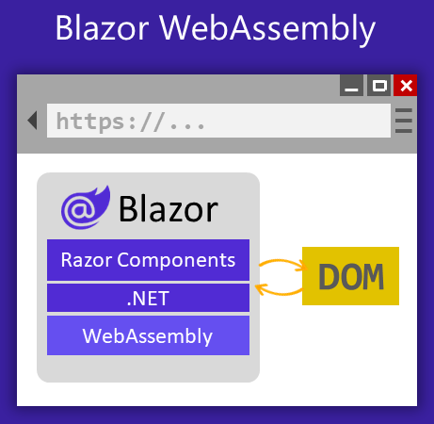
Blazor!
Overview
Web framework for building web UI components
Razor components -> server-side (Blazor Server), or client-side (Blazor WASM)
Notes:
Blazor is a web framework for building web UI components (Razor components) that can be hosted in different ways. Razor components can run server-side in ASP.NET Core (Blazor Server) versus client-side in the browser on a WebAssembly-based .NET runtime (Blazor WebAssembly, Blazor WASM). You can also host Razor components in native mobile and desktop apps that render to an embedded Web View control (Blazor Hybrid). Regardless of the hosting model, the way you build Razor components is the same. The same Razor components can be used with any of the hosting models unchanged.
Using hosted Blazor WebAssembly, you get a full-stack web development experience with .NET, including the ability to share code between the client and server apps, support for prerendering, and integration with MVC and Razor Pages. A hosted client app can interact with its backend server app over the network using a variety of messaging frameworks and protocols, such as web API, gRPC-web, and SignalR (Use ASP.NET Core SignalR with Blazor).

Slide 17
Blazor!
Hosting Models
Feature | Blazor Server | Blazor WebAssembly (WASM) | Blazor Hybrid
Complete .NET API compatibility | ✔️ | ❌ | ✔️
Direct access to server and network resources | ✔️ | ❌† | ❌†
Small payload size with fast initial load time | ✔️ | ❌ | ❌
Near native execution speed | ✔️ | ✔️‡ | ✔️
App code secure and private on the server | ✔️ | ❌† | ❌†
Run apps offline once downloaded | ❌ | ✔️ | ✔️
Static site hosting | ❌ | ✔️ | ❌
Offloads processing to clients | ❌ | ✔️ | ✔️
Full access to native client capabilities | ❌ | ❌ | ✔️
Web-based deployment | ✔️ | ✔️ | ❌

Slide 18
Platform Considerations
Incompatibilities
File system, sockets, threading
System.Security.Cryptography
Client secrets (in client projects)

Slide 19
Getting Started
Prerequisites
Get a free developer sandbox that provides a renewable 90-day Microsoft 365 E5 developer subscription
Run the sample
Download or clone the Office Add-ins samples repository
See the repo’s README.md for more information: Office-Add-in-samples/Samples/blazor-add-in/outlook-blazor-add-in at main · OfficeDev/Office-Add-in-samples (github.com)

Slide 20
Running The Sample
Common Issues
Use multi-factor auth if using an account from an Office Developer Sandbox tenant

Slide 21
Next Steps
Resources
Blazor | Build client web apps with C# | .NET (microsoft.com)
ASP.NET Core Blazor fundamentals | Microsoft Docs
Tooling for ASP.NET Core Blazor | Microsoft Docs
ASP.NET Core Blazor project structure | Microsoft Docs
ASP.NET Core Blazor hosting models | Microsoft Docs
ASP.NET Core Blazor JavaScript interoperability (JS interop) | Microsoft Docs
Host and deploy ASP.NET Core Blazor | Microsoft Docs
ASP.NET Core Razor component lifecycle | Microsoft Docs
Debug ASP.NET Core Blazor WebAssembly | Microsoft Docs
ASP.NET Core Blazor dependency injection | Microsoft Docs

Slide 22


Community spotlight
Thank you!
Thomas Barnekow
https://github.com/OfficeDev/Office-Add-in-samples
https://pnp.github.io/recognitionprogram/

Slide 23
Question:
Our add-in needs the MIME representation of an e-mail message, the conversationId and the internetMessageId.
Would it be possible to add support for these properties to office.js?
Currently we need to use Outlook REST API (or MS-Graph in the future) to get these values
Answer:
We currently support those properties here are the docs Office.MessageRead interface - Office Add-ins | Microsoft Docs
Q&A

Slide 24
Question:
Consideration for existing add-ins that use the Outlook REST API is very helpful. Eventually, will all add-ins (existing and new add-ins) be able to use the Outlook REST API until Office 2019 support? I think this is very important, so could you please announce the decision on a dedicated page?
Answer:
Yes they will and we have already added this to our docs, in this page specifically. Use the Outlook REST APIs from an Outlook add-in - Office Add-ins | Microsoft Docs
Q&A

Slide 25



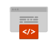


New to Office Add-ins?
 | Documentation | https://aka.ms/office-add-ins-docs
 | Quick starts | Outlook, Excel, Word, PowerPoint
 | Script Lab | https://aka.ms/getscriptlab
 | Samples | https://aka.ms/officeaddinsamples
 | Microsoft 365 Developer Program | https://aka.ms/M365devprogram
 | Office Scripts | aka.ms/office-scripts-docs
Notes:
m365-dev-sig

Slide 26
Engage with the team
Engagement | Where to go
Technical questions about Office Add-ins | https://aka.ms/office-addins-dev-questions [office-js-dev] [office-addins-dev] https://stackoverflow.com [office-js] [outlook-web-addins] [office-scripts]
Product bugs | https://github.com/OfficeDev/office-js
Feature requests and ideas | https://aka.ms/m365dev-suggestions
Send a Smile or Frown | Inside Office
Notes:
m365-dev-sig

Slide 27
Microsoft 365 developer community calls
Microsoft 365 platform call (weekly) https://aka.ms/m365-dev-call
Microsoft 365 & Power Platform Development (bi-weekly) https://aka.ms/m365-dev-sig
Viva Connections &
SharePoint Framework (bi-weekly) https://aka.ms/spdev-spfx-call
Adaptive Cards (monthly) https://aka.ms/adaptivecardscommunitycall
Microsoft identity platform (monthly) https://aka.ms/IDDevCommunityCalendar
Office Add-ins (monthly) https://aka.ms/officeaddinscommunitycall
Power Platform (monthly) https://aka.ms/PowerPlatformMonthlyCall
All calls and assets: https://aka.ms/m365pnp
Notes:
m365-dev-sig

Slide 28
Thank you
Recording will be available in 24 hours on
Microsoft 365 Community (PnP) YouTube channel
https://aka.ms/M365PnP/videos
(subscribe today)
Follow us on Twitter
@Microsoft365Dev | @M365PnP
Next call: October 12th at 8:00 AM Pacific Time
https://aka.ms/officeaddinscommunitycall
Agenda: https://aka.ms/officeaddinsagenda
Submit your questions: https://aka.ms/officeaddinsform

